Slide 1
Continuous Monitoring
SE489: DevOps Engineering

Slide 2
Outline
Why we need Continuous Monitoring?
What is Continuous Monitoring?
Continuous Monitoring Tools
What is Nagios?
Nagios Case Study

Slide 3
Why we need Continuous Monitoring?

Slide 4
Why we need Continuous Monitoring?
Failure of CI/CD Pipelines
Application Issues
Infrastructure Issues
Static Code Analysis

Slide 5
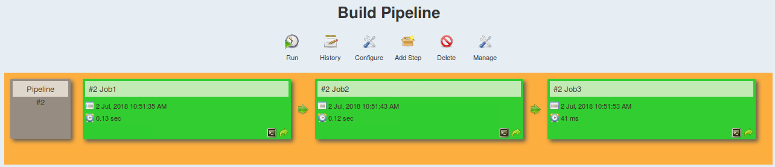
Why we need Continuous Monitoring?
Issues with CI/CD Pipelines:
Rapid introduction of performance problems and errors
Rapid introduction of new endpoints causing monitoring issues
Lengthy root cause analysis as the number of services expands

Slide 6
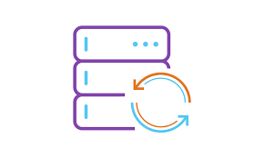

Why we need Continuous Monitoring?
</>
Running APM solutions earlier in lifecycle
Production-like Environment
Feedback of how application will perform in production
Taking corrective actions

Slide 7

Why we need Continuous Monitoring?
Server health cannot be compromised at any cost
Increase response time

Slide 8

Why we need Continuous Monitoring?
Static code analysis will give insights about your code

Slide 9
What is Continuous Monitoring?

Slide 10
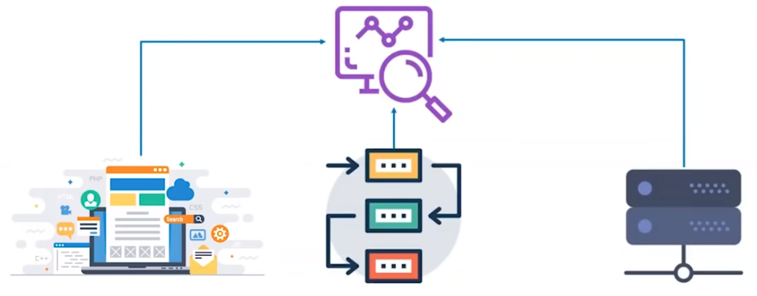
What is Continuous Monitoring?
Effective comprehensive monitoring approach is essential for visibility of your application and Infrastructure

Slide 11
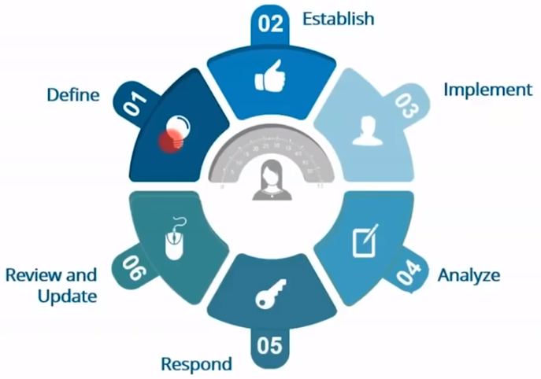
Continuous Monitoring Phases - NIST

Slide 12
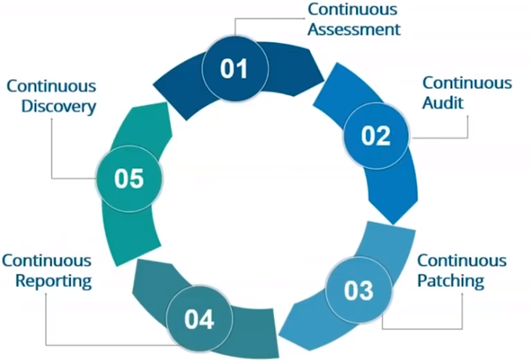
Continuous Monitoring Phases - Patriot

Slide 13
Continuous Monitoring Tools

Slide 14


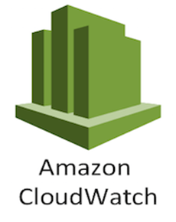



Continuous Monitoring Tools

Slide 15
What is Nagios?

Slide 16
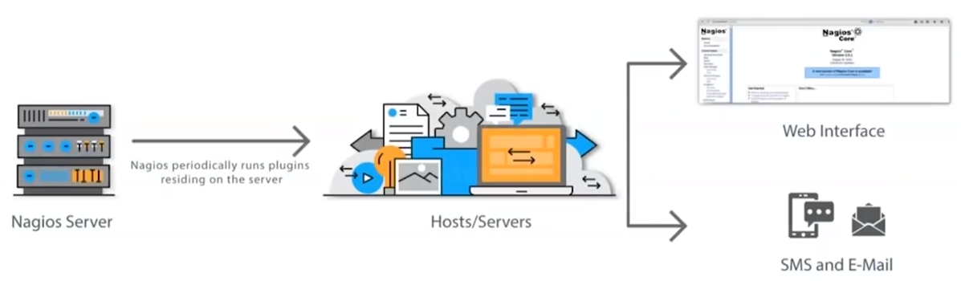
What is Nagios?
Nagios monitors your entire IT infrastructure to ensure systems, applications, services, and business processes are functioning properly.

Slide 17
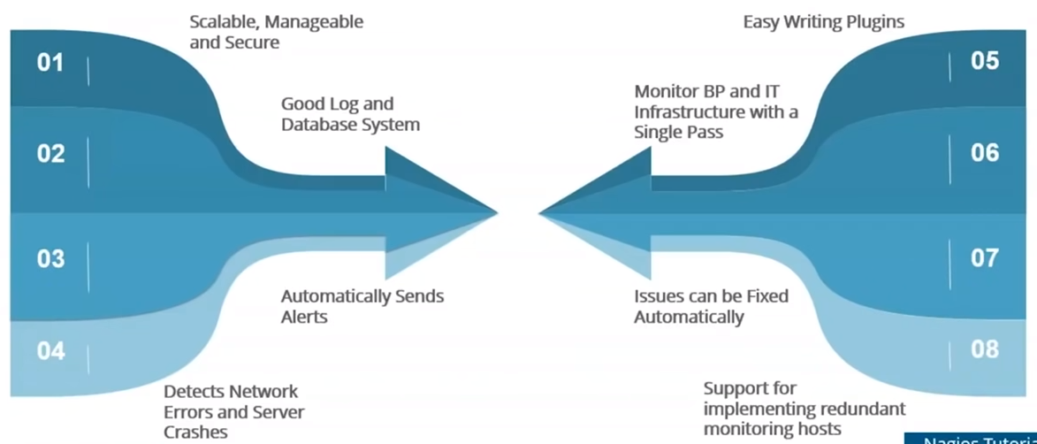
Nagios Features

Slide 18
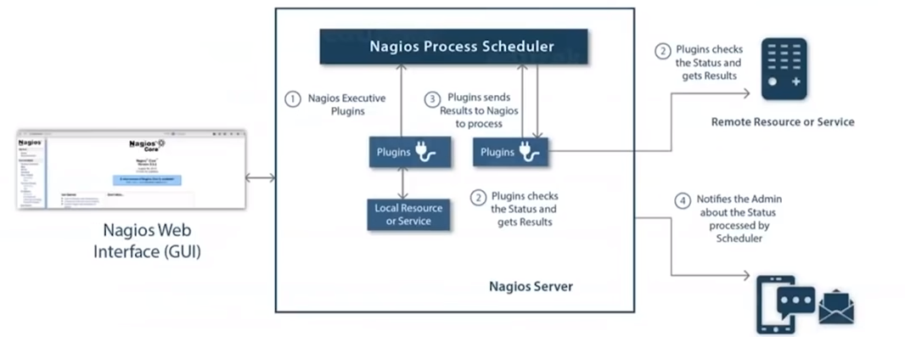
Nagios Architecture
Nagios is built on server/agents architecture
Nagios server is running on a host, and plugins interact with local and remote nodes
Plugins will send information to the Scheduler

Slide 19
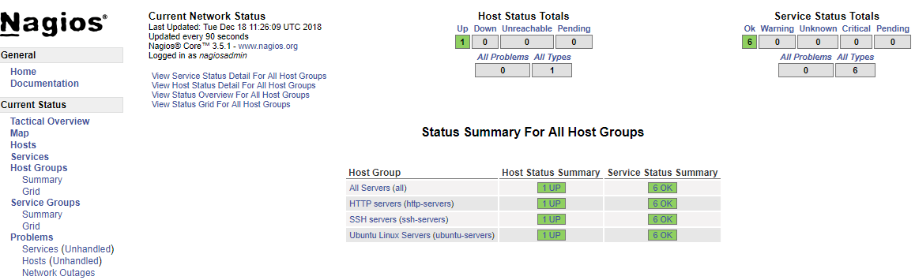
Nagios Dashboard

Slide 20
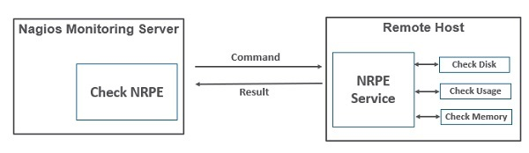
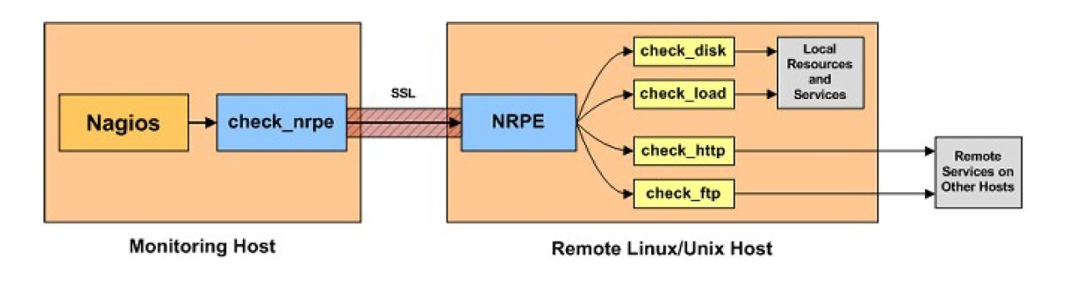
Monitoring Remote Linux Hosts

Slide 21
Nagios Case Study

Slide 22
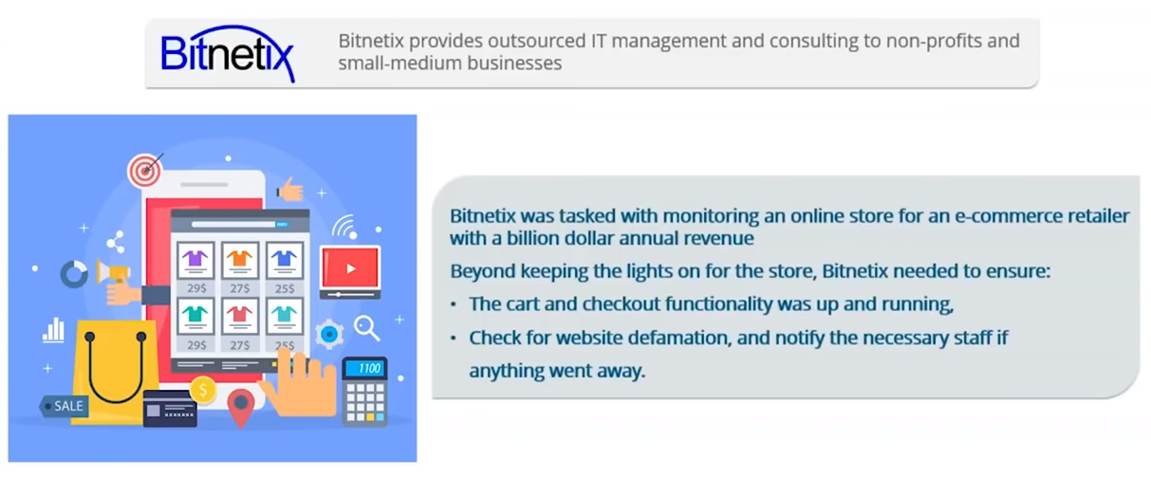
Nagios Case Study - Bitnetix
Bitnetix was tasked with monitoring an online store for an e-commerce retailer with a billion dollar annual revenue.
Beyond keeping the lights on for the store, Bitnetix needed to ensure:
The cart and checkout functionality was up and running
Cehck fro website defamation, and notify yhe necessary staff if anything went away

Slide 23
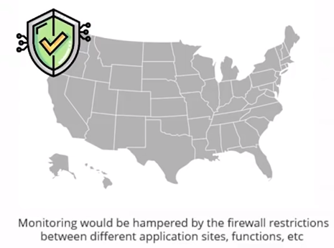

Challenge
Bitnetix hit a roadblock upon realizing that the client's data center was located in Seacacus, New Jersey, more than 500 miles away from their staff in Rochester, NY
Dev
Test
Prod

Slide 24
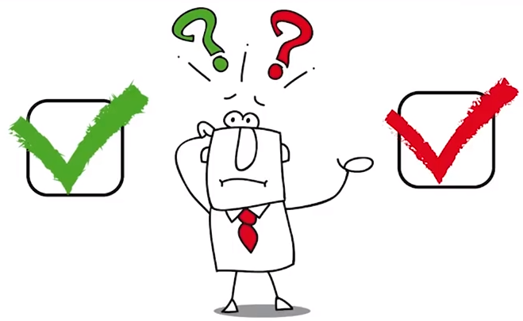
Challenge
Bitnetix hit a roadblock upon realizing that the client's data center was located in Seacacus, New Jersey, more than 500 miles away from their staff in Rochester, NY
Most of the notifications sent to the client were ignored because there were so many false positives

Slide 25
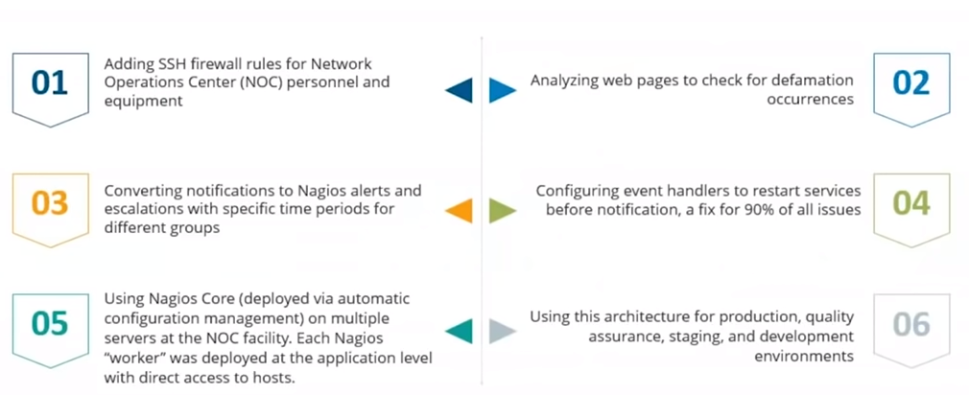
Solution

Slide 26
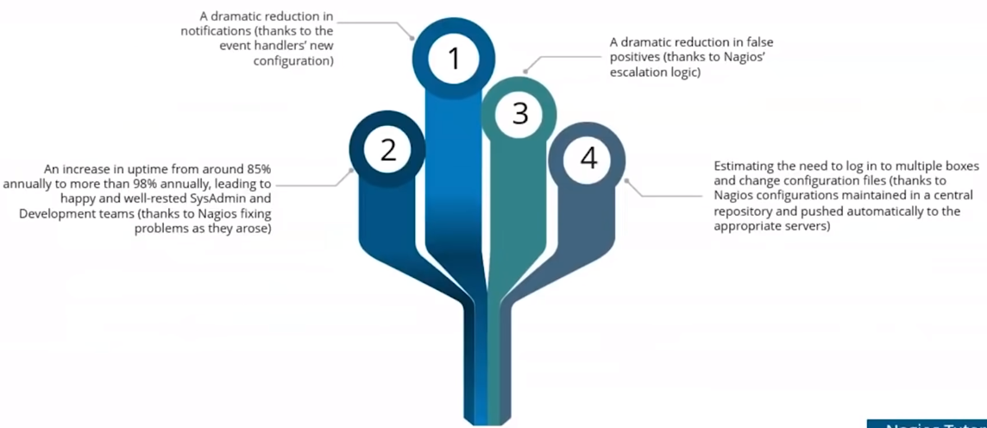
Results

